Slide 1
Exploring the relationships of different BLS series

Slide 2
Who are we? …DOL
Domingo Angeles
Kevin Reuss
Jeff Bricker
BLS – yadda, yadda
Employment and Training Administration (ETA)
Office of Policy Development and Research
Division of Data Analytics and Strategic Planning
Economist
BLS – yadda, yadda

Slide 3
BLS Data Used
Producer Price Index (PPI)
Consumer Price Index (CPI)
Current Employment Statistics (CES)
Inflation measured in domestic industries at earlier stages of production.
Monthly Data
Example uses: contract escalation, etc.
Inflation measured from an end consumer via a basket of goods.
Monthly data
Example uses: cost of living adjustments, etc.
Employment, hours, and earnings of workers
By industry
Monthly data

Slide 4
Differences between the PPI and CPI
https://www.bls.gov/ppi/ppicpippi.htm
Scope / Coverage
Categorization
Other Technical Aspects
Data collection continuous versus once a month
https://www.investopedia.com/ask/answers/08/ppi-vs-cpi.asp

Slide 5
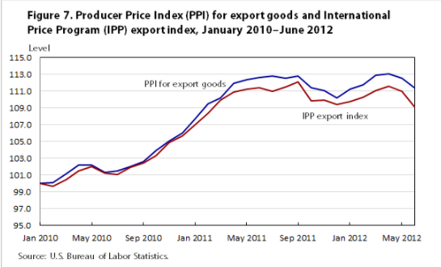
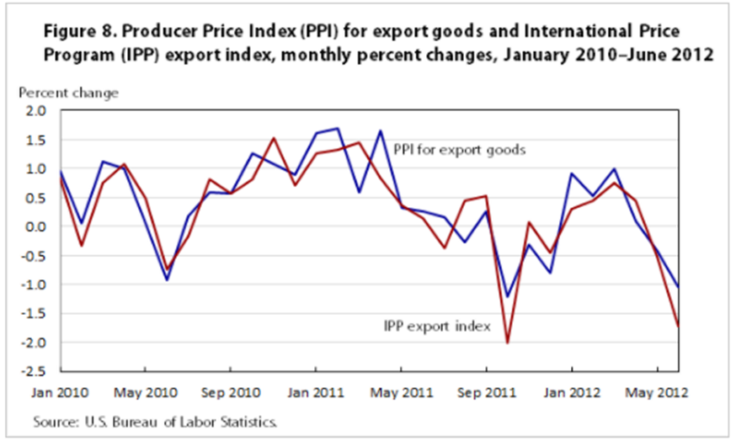
Original Idea – PPI/CPI Relationship
Identify which PPI and CPI series are related to each other (e.g., the meats PPI and the grocery CPI)
Measure the presence of a “pass through”
Time – how long (e.g., there is a month lag in the is the change)
Magnitude – how much (e.g., 75% of the change is explained by the relationship)

Slide 6
Issues Encountered with this Idea
Initial exploration of a limited number of series identified some complications
The direction of the relationships wasn’t always clear and/or as would be expected
The identification of which series may be inter-related proved to be more complicated than expected

Slide 7
New Idea: Identifying Groupings of Series
Purpose
Plan
Data Prep

Slide 8
Correlation Matrix of PPI Series

Slide 9
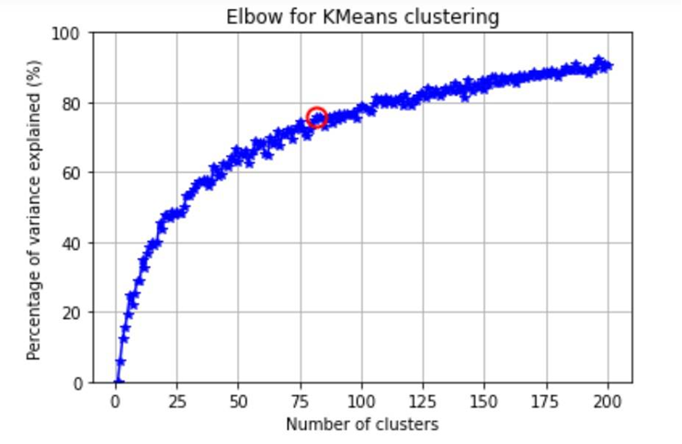
PPI Cluster Analysis
Elbow curve of KMeans clustering
Show HTML plot of two medium sized clusters

Slide 10
Expand the Cluster Analysis to other Data
Wrangle the other data series to create a clean/full dataset
Use BLS API to bring in hundreds of series for each Index/Survey
Significant work due to classification differences
Cluster CPI and CES data by industry series
Compare contrast the clusters resulting from the different data sources

Slide 11
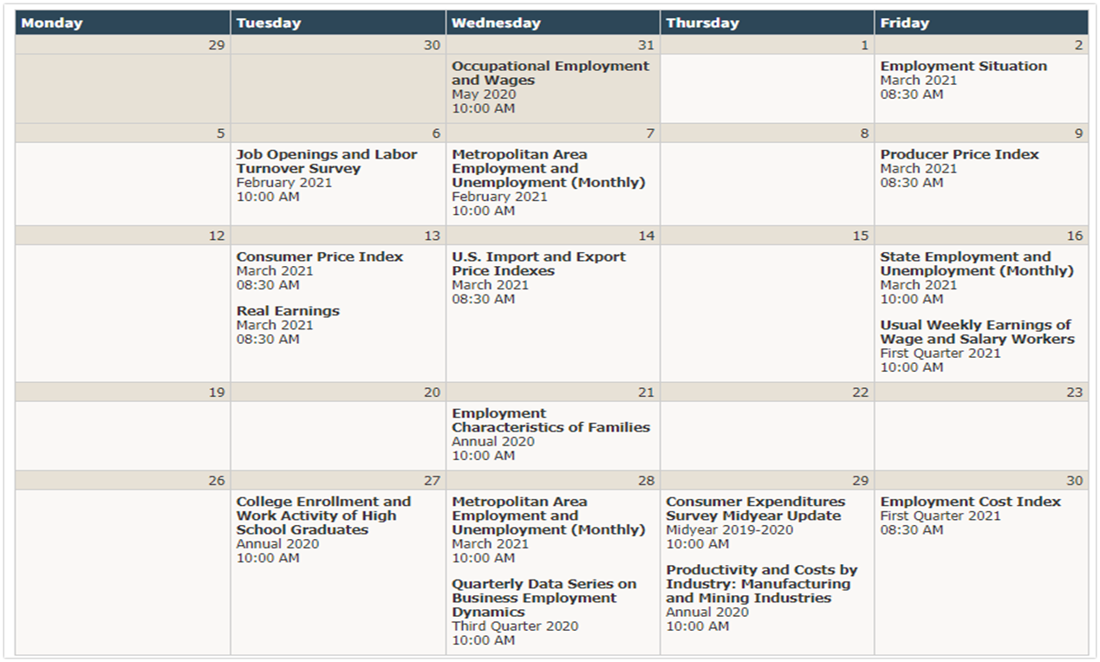
How can this clustered data be used?
Inform prediction models
Feature selection and parameter tuning
Prediction model based on release schedule

Slide 12
Capstone Summary
Build prediction models

